Slide 1
Database Management System
Lecture # 3-4

Slide 2
Typical Functionality of Database
Define a database : in terms of data types, structures and constraints
Construct or Load the Database on a secondary storage medium
Manipulating the database : querying, generating reports, insertions, deletions and modifications to its content
Concurrent Processing and Sharing by a set of users and programs – yet, keeping all data valid and consistent

Slide 3
Typical Functionality of Database
Other features:
Protection or Security measures to prevent unauthorized access
“Active” processing to take internal actions on data
Recovery Services
Authorization Services
Support for Data Communication

Slide 4
Basics of Business Logic
Business logic is also known as "domain logic."
Business logic is the custom rules or algorithms that handle the exchange of information between a database and user interface.
It is the part of the program that encodes the real-world business rules that determine how data can be created, stored, and changed
Business logic is the programming that manages communication between an end user interface and a database.
The main components of business logic are business rules and workflows

Slide 5
Basics of BL: Business Rules
Brief, precise, and unambiguous description of a policy, procedure, or principle
It is specific procedure & is used to Model real-life business objects
Imposes some form of constraint on a specific aspect of the database

Slide 6
Basics of BL: Sources of Business Rules
Company managers
Policy makers
Department managers
Written documentation
Direct interviews with end users

Slide 7
Reasons for Identifying and Documenting Business Rules
Help standardize company’s view of data
Communications tool between users and designers
Allow designer to:
Understand the nature, role, scope of data, and business processes
Develop appropriate relationship participation rules and constraints
Create an accurate data model

Slide 8
Translating Business Rules into ‘Data Model Components’
Nouns translate into entities
Verbs translate into relationships among entities
Relationships are bidirectional
Questions to identify the relationship type
How many instances of ‘B’ are related to one instance of ‘A’?
How many instances of ‘A’ are related to one instance of ‘B’?

Slide 9
Basics of Business Logic
Workflow
It is the definition, execution and automation of business processes: where tasks, information and documents are passed from one person to another for action according to a set of procedural rules.
It involves work by one or more people, and transforms materials, information or services

Slide 10
Business Object Vs Business Logic
Business object :
A business object is a representation of a thing active in the business domain, including at least its business name and definition, attributes, behavior, and relationships. A business object may represent, for example, a person, place or concept. The representation may be in a natural language, a modeling language, or a programming language.
Business logic:
Prescribes how business objects interact with one another
Enforces the routes and the methods by which business objects are accessed and updated

Slide 11
Data Modeling and Data Models
Data modeling: It is a process of creating a data model for the data to be stored in a Database i.e. a conceptual representation of
Data objects
The associations between different data objects
The rules.
Data modeling helps in the visual representation of data and enforces business rules, regulatory compliances, and government policies on the data. Data Models ensure consistency in naming conventions, default values, security while ensuring quality of the data.

Slide 12
Data Model
A representation of real world objects, events and their associations is called model
The model helps the user to understand the complexities of the real world environment
The data modeling use a process of identifying data objects and the relationships between them
Describes structure of the database
Data model is a collection of concepts to describe the structure of a database

Slide 13
Data Models Cont…
The data modeling or data structuring represents the nature of the data & business logic to control the data. It also organize the database
Data model helps to communicate between business people who require the computer system & the technical people who can fulfill their requirement’s
Aim is to support the development of information systems by providing the definition and format of data.
If the same data structures are used to store and access data then different applications can share data.

Slide 14
Why use Data Model?
The primary goal of using data model are:
Ensures that all data objects required by the database are accurately represented. Omission of data will lead to creation of faulty reports and produce incorrect results.
A data model helps design the database at the conceptual, physical and
logical levels.
Data Model structure helps to define the relational tables, primary and foreign keys and stored procedures.
It provides a clear picture of the base data and can be used by database
developers to create a physical database.
It is also helpful to identify missing and redundant data.
Though the initial creation of data model is labor and time consuming, in the long run, it makes your IT infrastructure upgrade and maintenance cheaper and faster.

Slide 15
Types of Data Models
Conceptual data models (CMDs):
Higher level model that includes only business rules and concepts with a defined scope. This model is created first when building an application.
Logical Data models (LDMs):
A more detailed version built of the CDM that defines attributes and the relationships (aka. business rules) between different entities. This model is created second.
Physical Data models (PDMs):
An even more detailed version built of the LDM that contains technical details (aka. internal schema) pertaining to the application design. This model is created last. It tells us that how data is stored on physical storage.

Slide 16
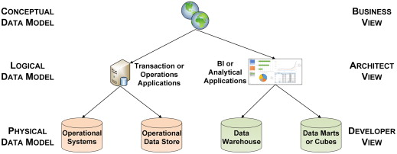
Types of Data Models: Sample Illustration

Slide 17
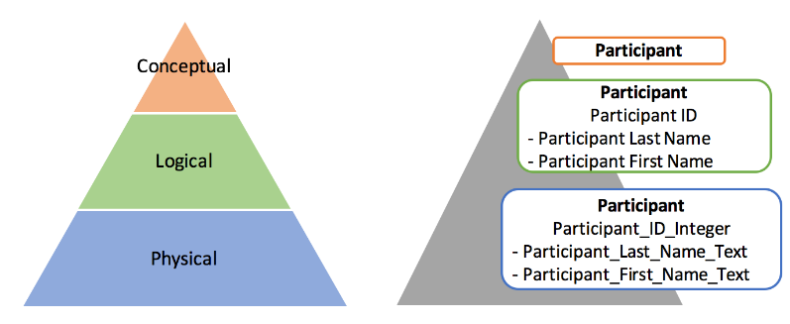
Sample Example: 3 types of data models

Slide 18
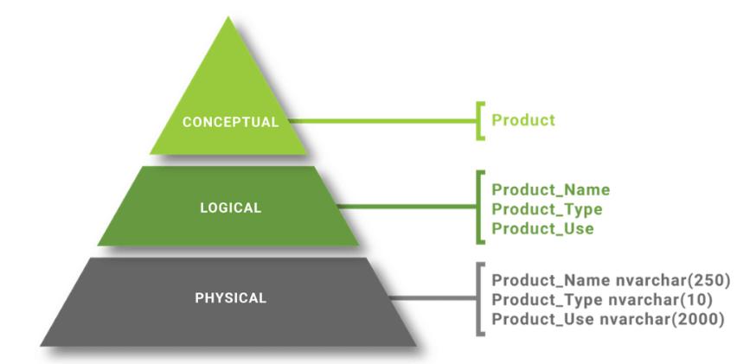
Sample Example: 3 types of data models

Slide 19
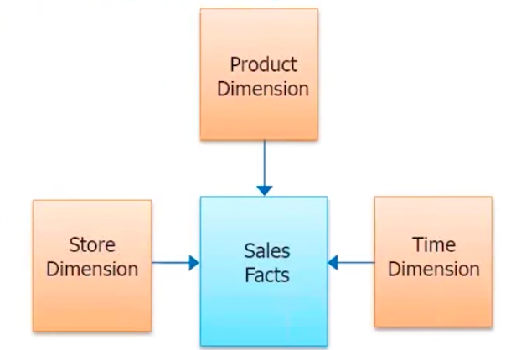
Example of conceptual model
Conceptual model for supermarket who want to measure the sales

Slide 20
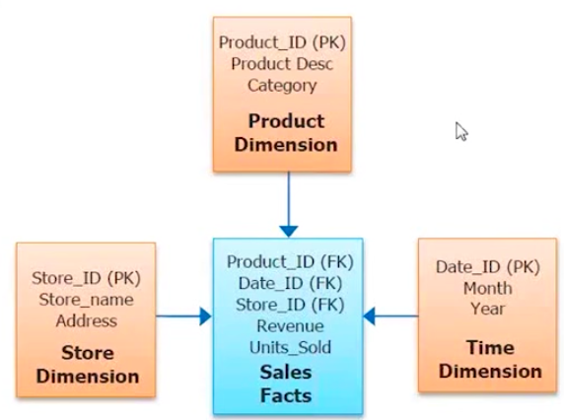
Example of Logical Data Model
Extension of the conceptual model that includes relationships and entities which describes data in more details . each entity will have attributes defined primary key for each entity will be defined and the foreign key linking the different entity will be defined. Tables can also be normalized n this model .

Slide 21
Example of Physical Data Model
Physical model represents how the model will be built in the database.
This is a representation of your physical data model. When you move from logical to physical model
Entities will become tables , attributes will become column names , data types for each columns will be specified along with precision and scale, primary key and foreign keys will be specified , column constraints will be specified.

Slide 22
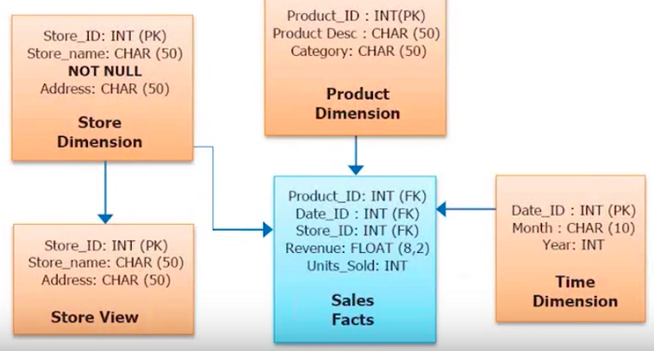
Example of Physical Data Model

Slide 23
Thanks

